Slide 1
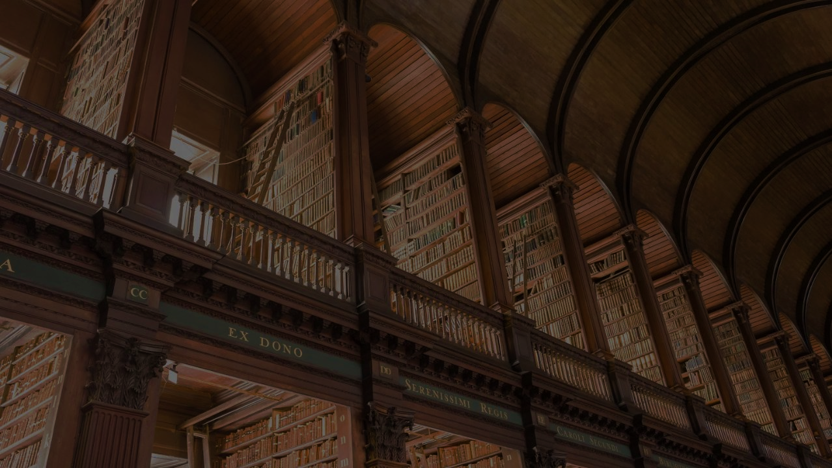
SmartLibraryApplication
Client - Greenfield Public Library
Submitted by
Meghana G S
Jeevan Sai Javvaji
Vedika Panchamahalkar
Chinnapareddy Yakkanti
Priyanka Yerumsetty

Slide 2
Use Case Name: User Registration ID: UC-1 Priority: High
Actor: Student, Faculty, Public User
Description: Allows users to register and access the system.
Trigger: A new user wants to create an account.
Preconditions: The system must be accessible online.
Normal Flow: User navigates to the registration page. Fill in the registration form with name, email, password, and user role. Submits the form. The system validates email and stores user data. The system confirms registration.
Postconditions: The user is registered and can log in.

Slide 3
Use Case Name: User Login ID: UC-2 Priority: High
Actor: Student, Faculty, Public User
Description: Allows users to log into the system.
Trigger: A registered user attempts to log in.
Preconditions: The user must be registered.
Normal Flow: User navigates to the login page. Enters login credentials. System validates credentials. If valid, access is granted; otherwise, an error message is displayed.
Postconditions: The user gains access to their account.

Slide 4
Use Case Name: Book Borrowing ID: UC-3 Priority: High
Actor: Student, Faculty, Public User
Description: Allows users to borrow books from the library.
Trigger: A user selects a book to borrow.
Preconditions: The user is logged in. The book is available.
Normal Flow: User navigates the book catalog. Selects a book and clicks on the borrow option. The system verifies user eligibility and book availability. The system records the transaction and updates the due date. User receives a confirmation message.
Postconditions: The book is assigned to the user with a due date.

Slide 5
Use Case Name: Book Return ID: UC-4 Priority: High
Actor: Student, Faculty, Public User
Description: Allows users to return borrowed books.
Trigger: A user returns a borrowed book.
Preconditions: The user has an active borrowed book.
Normal Flow: User navigates to their borrowed book section. Select the book to return. The system updates book status and removes it from the user's borrowed list. If returned late, a fine notification is generated.
Postconditions: The book is marked as returned in the system.

Slide 6
Use Case Name: Request Approval ID: UC-5 Priority: High
Actor: Admin
Description: Allows admins to approve or deny book borrowing requests.
Trigger: A user submits a borrow request.
Preconditions: The user must have an active membership.
Normal Flow: Admin logs into the system. Navigates to the request approval section. Reviews pending borrow requests. Approves or denies the request. System updates book status accordingly
Postconditions: The book is either assigned or remains available

Slide 7
Use Case Name: Report Generation ID: UC-6 Priority: Medium
Actor: Admin
Description: Generates reports on book borrowings and returns.
Trigger: Admin requests a report.
Preconditions: The system has sufficient data.
Normal Flow: Admin logs into the system. Selects the report type (borrowed books, overdue books, user activity). The system fetches relevant data. Report is generated and available for download.
Postconditions: Reports are generated and stored for reference.

Slide 8
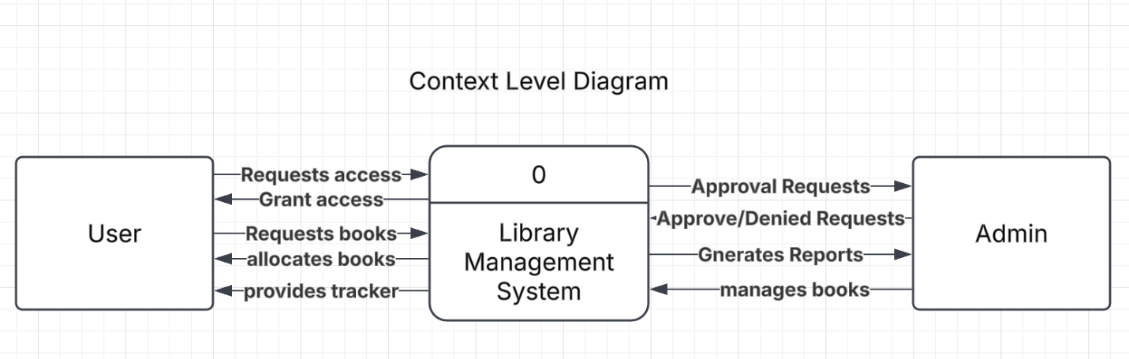
Context Level

Slide 9
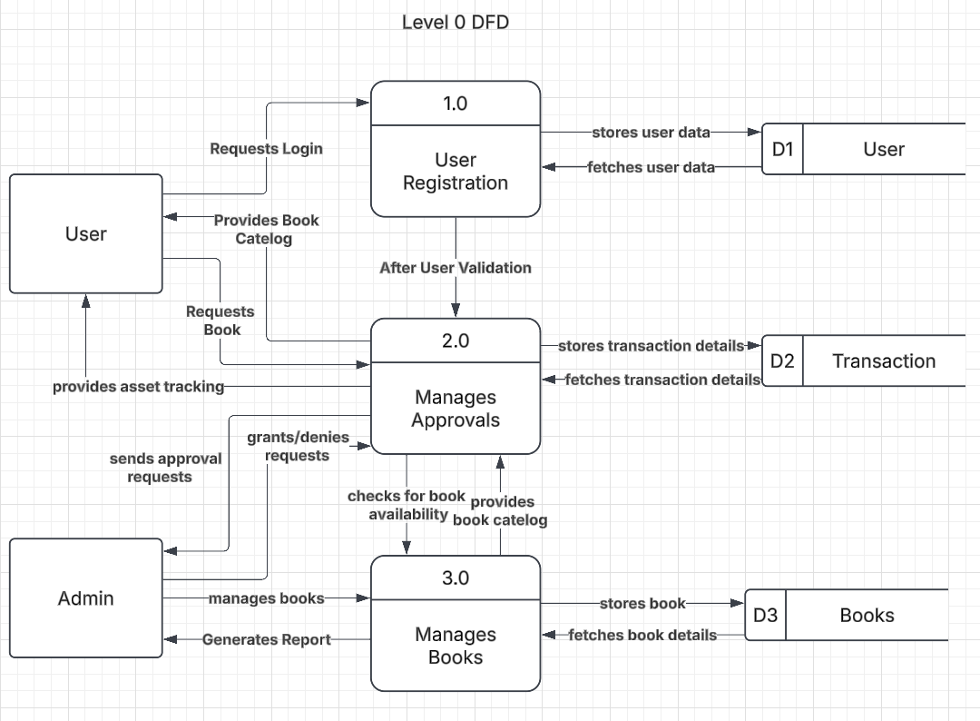
Level 0 DFD

Slide 10
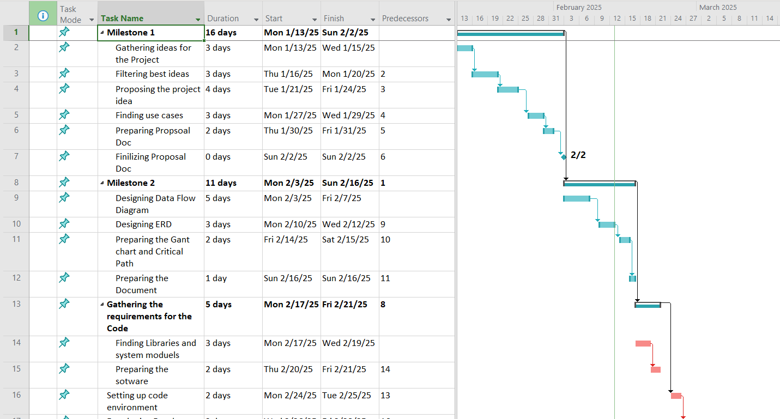
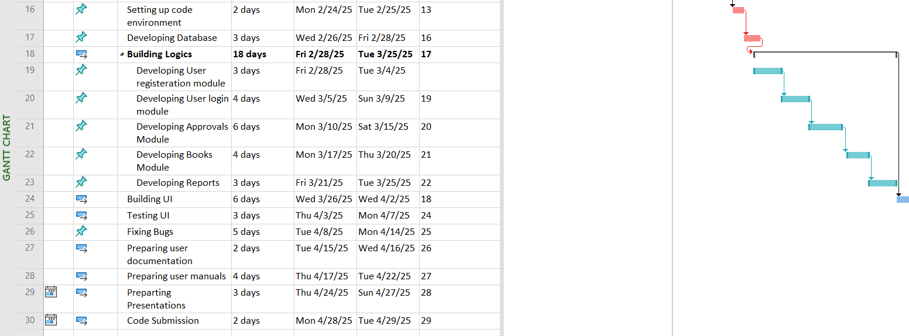
Task List

Slide 11
Critical Path

Slide 12
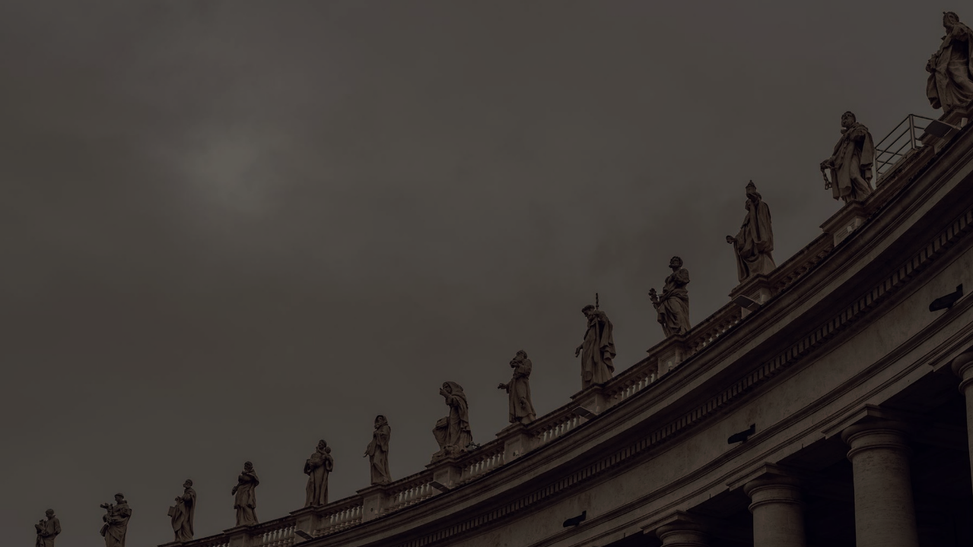
Thank You

